Slide 1

ASSIGNMENT II
BANK TRANSACTION DATABASE

Slide 2
PHAN TUAN KHAI_1952780
OUR TEAM
CAO HOANG KIET_2053165
CAO TUAN KIET _ 2053166

Slide 3
01
04
COMPLETE IMPLEMENTATION OF THE DATABASE TO DBMS
TUNING AND MANIPULATING BANK_TRANSACTIONDATABASE
TABLE OF CONTENTS
02
05
THE NORMAL FORM (NF) AND SOLUTIONS FOR IMPROVING THE NF
AN APPLICATION ON TOP OF THE DESIGNED DB SYSTEM
Insert initial data to the database and show the result.
03
Query, Trigger, Stored Procedure and Indexing
DATABASE SECURITY AND SOLUTION
About grant privilege to user
Analyze dependency and Normal Form of our database
Provide UI for user to work with DBMS

Slide 4

01
COMPLETE IMPLEMENTATION OF THE DATABASE TO DBMS

Slide 5
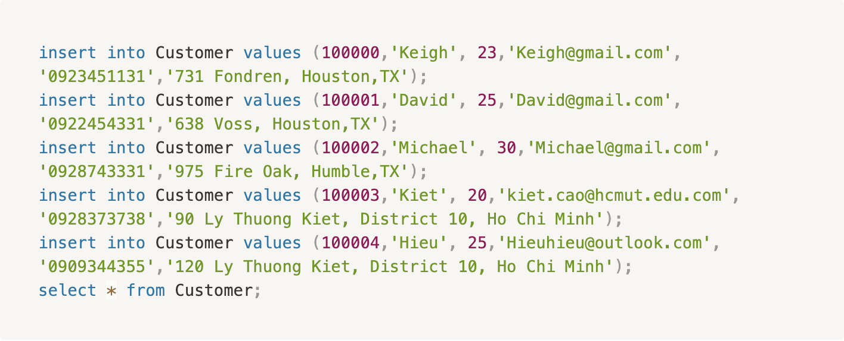
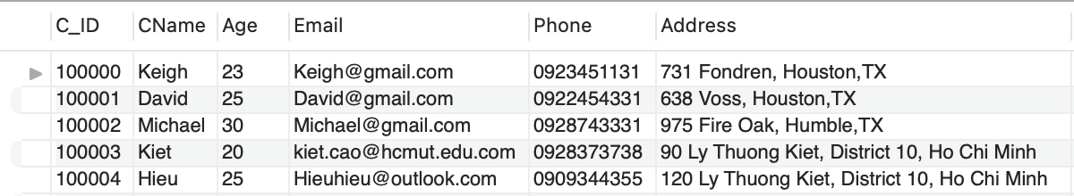
COMPLETE IMPLEMENTATION OF THE DATABASE TO DBMS
Customer Relation

Slide 6
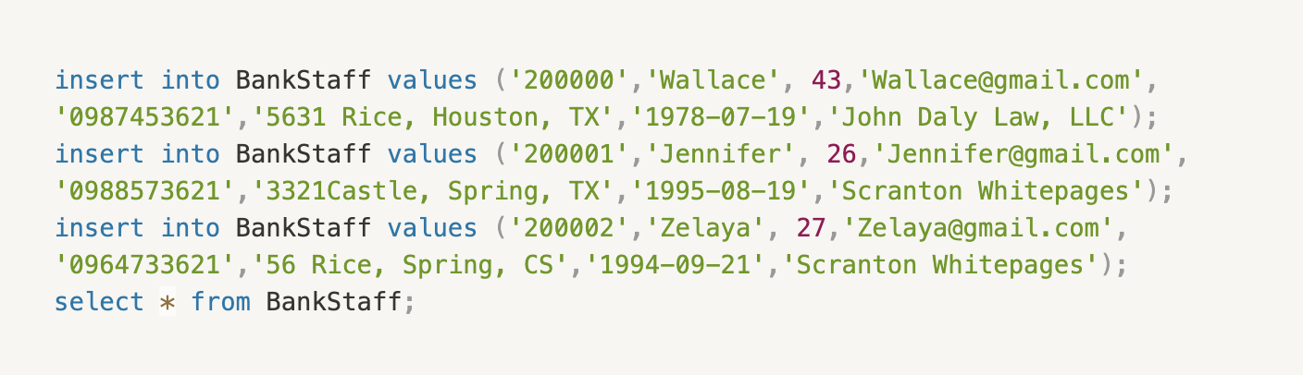
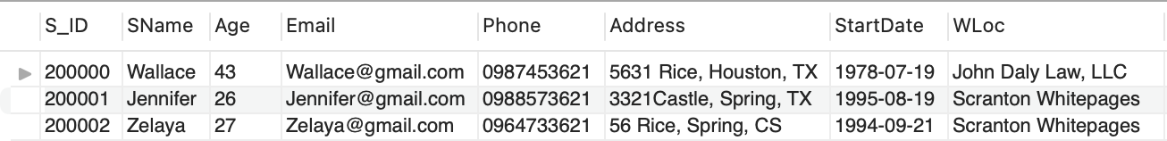
COMPLETE IMPLEMENTATION OF THE DATABASE TO DBMS
BankStaff Relation

Slide 7
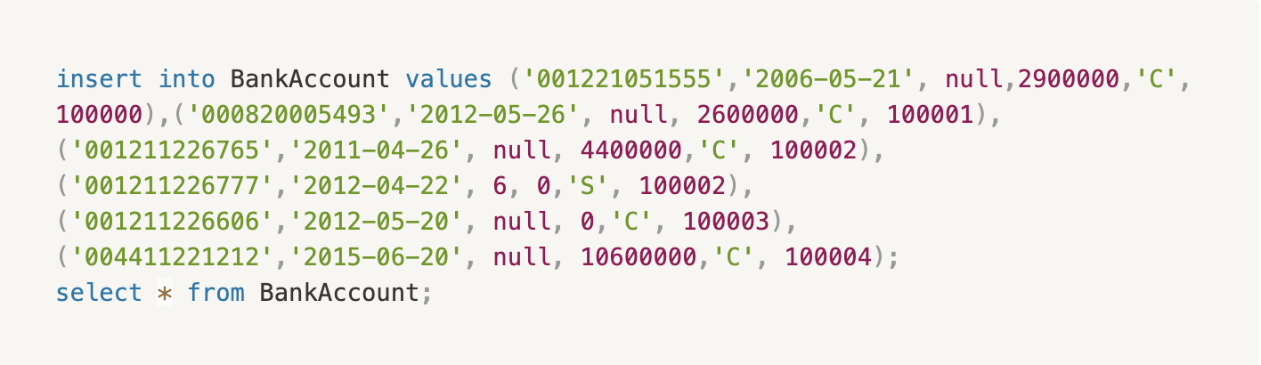
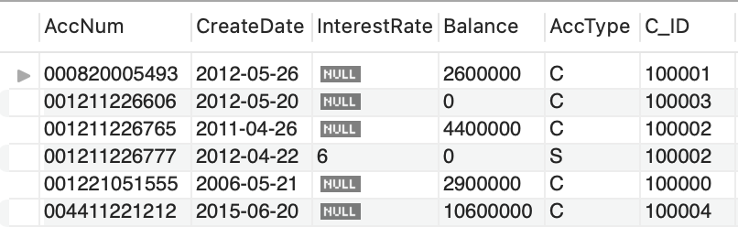
COMPLETE IMPLEMENTATION OF THE DATABASE TO DBMS
BankAccount Relation

Slide 8
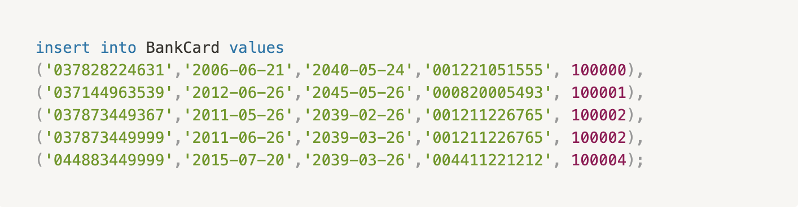
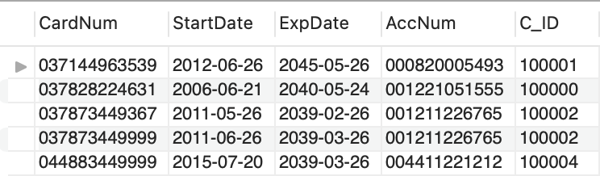
COMPLETE IMPLEMENTATION OF THE DATABASE TO DBMS
BankCard Relation

Slide 9
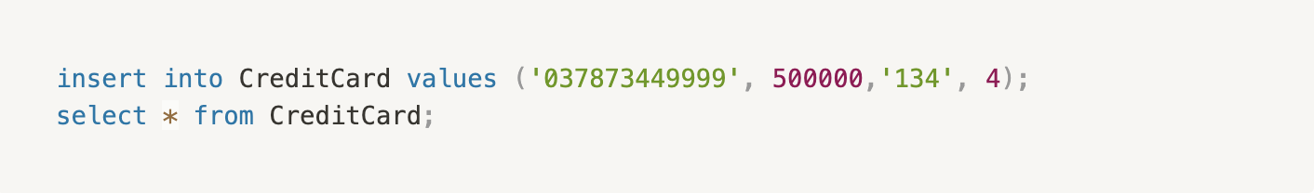
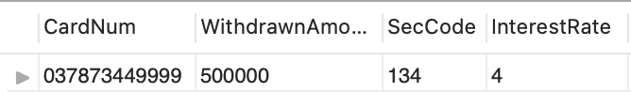
COMPLETE IMPLEMENTATION OF THE DATABASE TO DBMS
CreditCard Relation

Slide 10
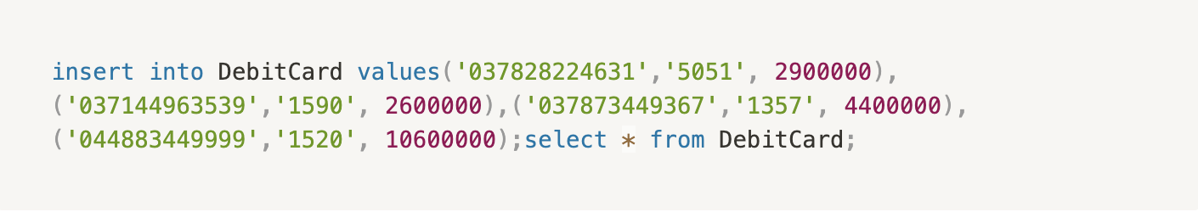
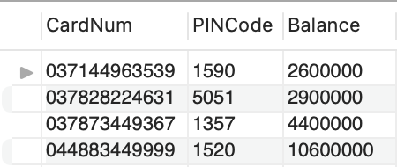
COMPLETE IMPLEMENTATION OF THE DATABASE TO DBMS
DebitCard Relation

Slide 11
02
THE NORMAL FORM (NF) AND SOLUTIONS FOR IM-PROVING THE NF

Slide 12
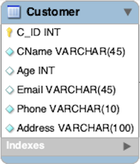
THE NORMAL FORM (NF) AND SOLUTIONS FOR IM-PROVING THE NF
Dependencies
C_ID → {CName, Age, Email, Phone, Address}

Slide 13
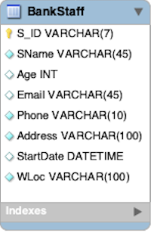
THE NORMAL FORM (NF) AND SOLUTIONS FOR IM-PROVING THE NF
Dependencies
S_ID → {SName, Age, Email, Phone, Address, StartDate, WLoc}

Slide 14
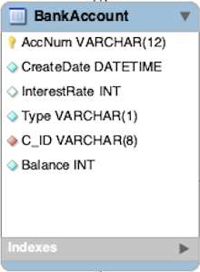
THE NORMAL FORM (NF) AND SOLUTIONS FOR IM-PROVING THE NF
Dependencies
AccNum → {CreateDate, InterestRate, Type, C_ID, Balance}

Slide 15
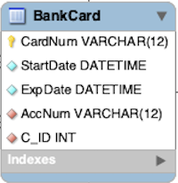
THE NORMAL FORM (NF) AND SOLUTIONS FOR IM-PROVING THE NF
Dependencies
CardNum → {StartDate, ExpDate, AccNum, C_ID}

Slide 16
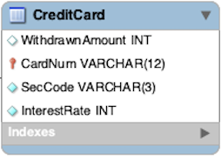
THE NORMAL FORM (NF) AND SOLUTIONS FOR IM-PROVING THE NF
Dependencies
CardNum →{WithdrawnAmount, SecCode, InterestRate}

Slide 17
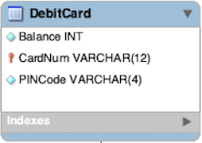
THE NORMAL FORM (NF) AND SOLUTIONS FOR IM-PROVING THE NF
Dependencies
CardNum →{Balance, PINCode}

Slide 18
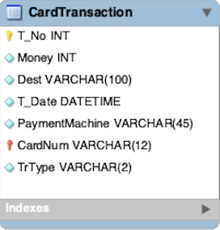
THE NORMAL FORM (NF) AND SOLUTIONS FOR IM-PROVING THE NF
Dependencies
{T_no, CardNum} → {Money, Dest, T_Date, PaymentMachine, Tr-Type}

Slide 19
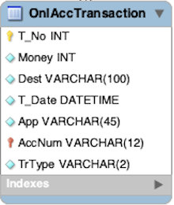
THE NORMAL FORM (NF) AND SOLUTIONS FOR IM-PROVING THE NF
Dependencies
{T_no, CardNum} →{Money, Dest, T_Date, App, TrType}

Slide 20
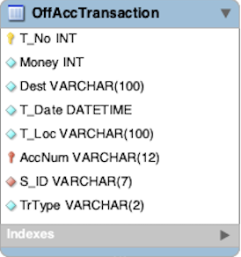
THE NORMAL FORM (NF) AND SOLUTIONS FOR IM-PROVING THE NF
Dependencies
{T_no, CardNum} →{Money, Dest, T_Date, T_Loc, S_ID, Tr-Type}

Slide 21
THE NORMAL FORM (NF) AND SOLUTIONS FOR IM-PROVING THE NF
Normal Form (NF)
Our Conclusion about NF of our database
First Normal Form (1NF)
All of our relation have all attribute containing atomic value and there isno nested relation. Therefore, all of our database’s relations are in 1NF

Slide 22
THE NORMAL FORM (NF) AND SOLUTIONS FOR IM-PROVING THE NF
Normal Form (NF)
Our Conclusion about NF of our database
Second Normal Form (2NF)
From all dependencies listed from our relations, non-prime attributes arefully functionally dependent on the primary keys of its relation. Thereforewe can conclude that our database’s relations are in 2NF

Slide 23
THE NORMAL FORM (NF) AND SOLUTIONS FOR IM-PROVING THE NF
Normal Form (NF)
Our Conclusion about NF of our database
Third Normal Form (2NF)
Consider dependencies listed from our relations, all attribute are dependenton superkey of its relation. Therefore we can conclude that our database’srelations are in 3NF

Slide 24
THE NORMAL FORM (NF) AND SOLUTIONS FOR IM-PROVING THE NF
Normal Form (NF)
Our Conclusion about NF of our database
Boyce-Codd Normal Form (BCNF)
Finally, among all dependencies, superkey is attributes that determineother attribute and the attributes that is dependent on superkey are notprime attribute, which satisfy the condition in definition of BCNF.

Slide 25
THE NORMAL FORM (NF) AND SOLUTIONS FOR IM-PROVING THE NF
Normal Form (NF)
Our Conclusion about NF of our database
Our database’s relation satisfy Boyce-Codd Normal Form. We did notmodify the original relational databse. Therefore, we can conclude that weminimized redundancy and the insertion, deletion, and update anomalies ofour database.

Slide 26
03
DATABASE SECURITY AND SOLUTION

Slide 27
DATABASE SECURITY AND SOLUTION
Create Account
Firstly, we create 3 accounts, namelyA1, A2, A3.

Slide 28
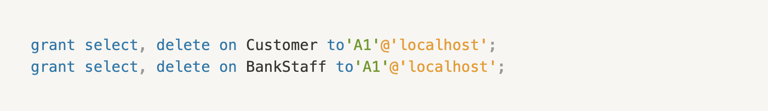
DATABASE SECURITY AND SOLUTION
Grant privilege
And we wants to grant A1 the privilege to insert and delete tuples in both of relations BankStaff and Customer, but we does not want A1 to be able to propagate these privileges to additional accounts, so we use the following codes

Slide 29
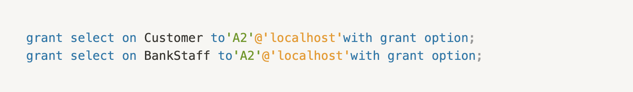
DATABASE SECURITY AND SOLUTION
Grant privilege
Suppose that we wants to allowA2to retrieve information from either of the two tables and also to be able to propagate the SELECT privilege to other accounts so we use the following codes

Slide 30
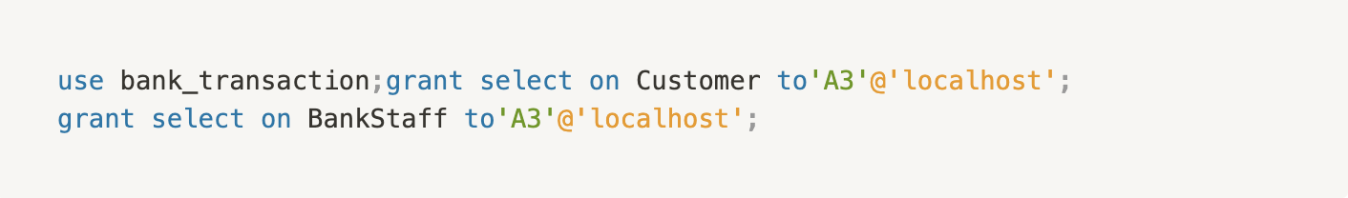
DATABASE SECURITY AND SOLUTION
Grant privilege
User A2 can grant the SELECT privilege on the Customer and BankStaff relations to A3 by issuing:

Slide 31

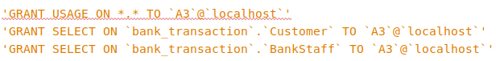
DATABASE SECURITY AND SOLUTION
Grant privilege
To check all privileges of userA3, we conduct the following codes:

Slide 32
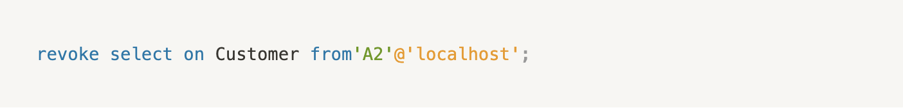
DATABASE SECURITY AND SOLUTION
Revoke privilege
Now to revoke SELECT privilege of user A2 on Customer’s table, we can issue:

Slide 33
04
TUNING AND MANIPULATING BANK_TRANSACTION DATABASE

Slide 34
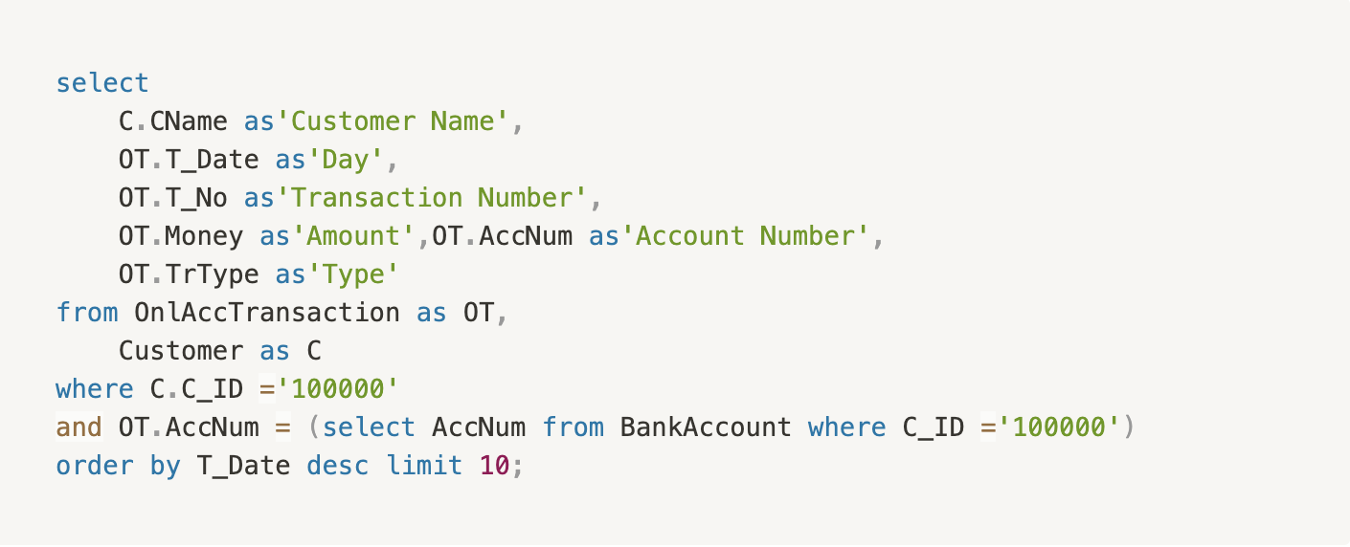
TUNING AND MANIPULATING BANK_TRANSACTION DATABASE
Retrieve data from our database
Find information (T_No, T_Date, Money, AccNum, TrType) aboutthe 10 most recent online transaction of Customer whose ID is 100000

Slide 35
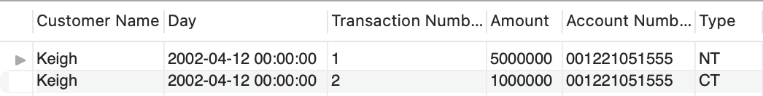
TUNING AND MANIPULATING BANK_TRANSACTION DATABASE
Retrieve data from our database
Find information (T_No, T_Date, Money, AccNum, TrType) aboutthe 10 most recent online transaction of Customer whose ID is 100000

Slide 36
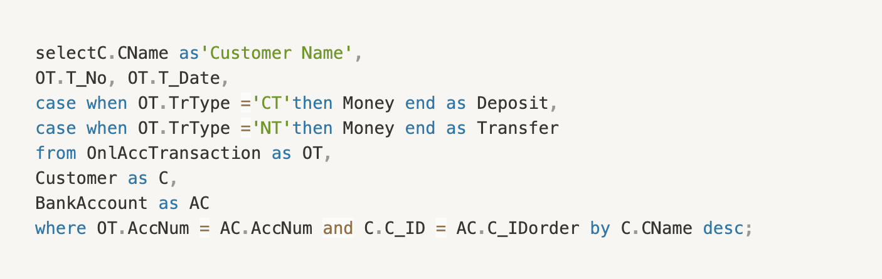
TUNING AND MANIPULATING BANK_TRANSACTION DATABASE
Retrieve data from our database
Find the online transaction history of all customer and classify theiramount of money involve into deposit or transfer column base on the trans-action type.

Slide 37
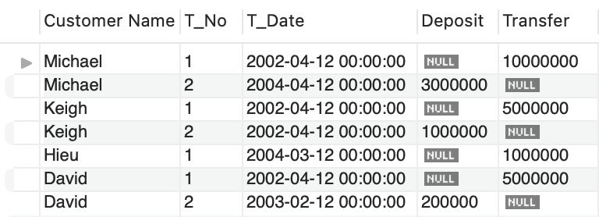
TUNING AND MANIPULATING BANK_TRANSACTION DATABASE
Retrieve data from our database
Find the online transaction history of all customer and classify theiramount of money involve into deposit or transfer column base on the trans-action type.

Slide 38
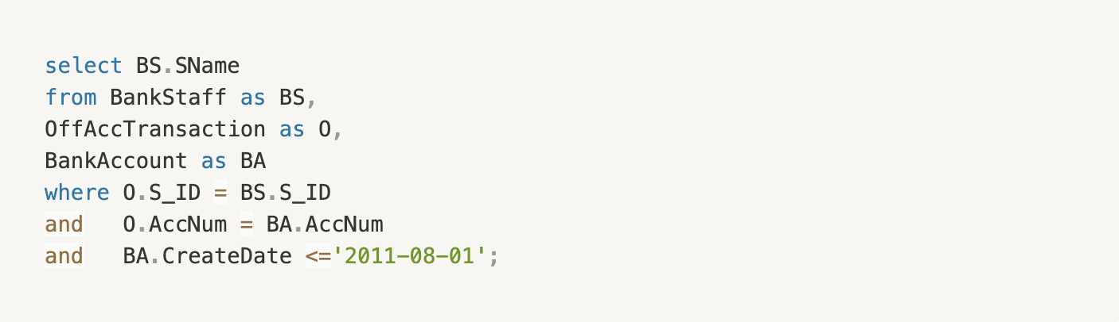
TUNING AND MANIPULATING BANK_TRANSACTION DATABASE
Retrieve data from our database
Find name of bank staffs who are responsible for accounts having CreateDate <= 2011-08-01.

Slide 39
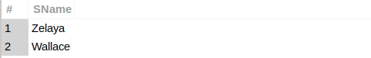
TUNING AND MANIPULATING BANK_TRANSACTION DATABASE
Retrieve data from our database
Find name of bank staffs who are responsible for accounts having CreateDate <= 2011-08-01.

Slide 40
TUNING AND MANIPULATING BANK_TRANSACTION DATABASE
Trigger for Online transaction our database
Our flow is to check if the account have enough money to transfer before transaction (We do not check if the transaction is deposit). After insertion, we will change the balance of the Bank Account and its relating Debit Cards to make sure that the Balance is up-to-date and consistence

Slide 41
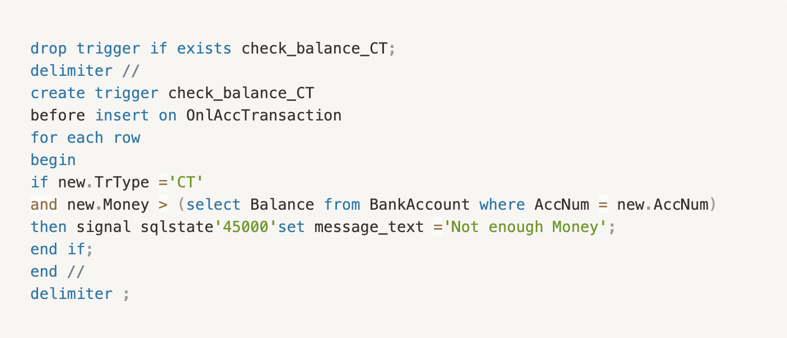
TUNING AND MANIPULATING BANK_TRANSACTION DATABASE
Trigger for Online transaction our database
Trigger for Online Transaction to make sure that they have enough money to transfer money

Slide 42
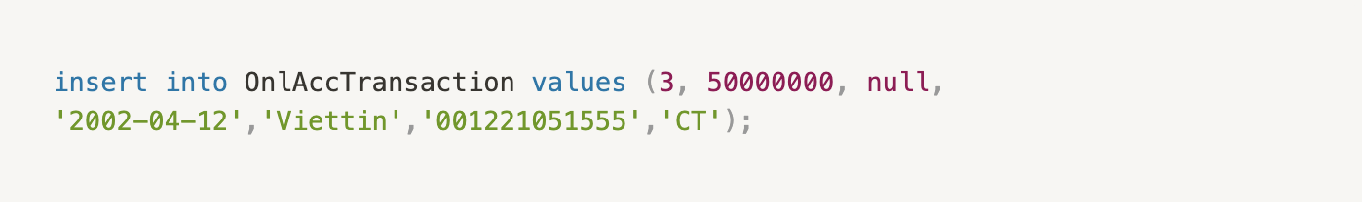
TUNING AND MANIPULATING BANK_TRANSACTION DATABASE
Trigger for Online transaction our database
Trigger for Online Transaction to make sure that they have enough money to transfer money
And we test with the following insertion.

Slide 43
TUNING AND MANIPULATING BANK_TRANSACTION DATABASE
Trigger for Online transaction our database
Trigger for Online Transaction to make sure that they have enough money to transfer money
And we test with the following insertion.

Slide 44
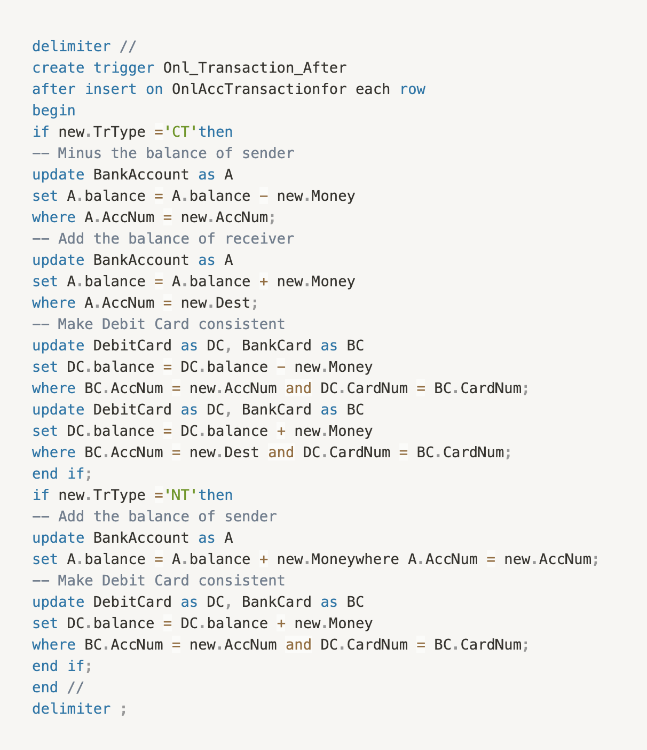
TUNING AND MANIPULATING BANK_TRANSACTION DATABASE
Trigger for Online transaction our database
Then we add trigger after insertion to make things up-to-date and consistent. ’CT’ means you transfer your money to another account and ’NT’ means you deposit amount of money to your account

Slide 45
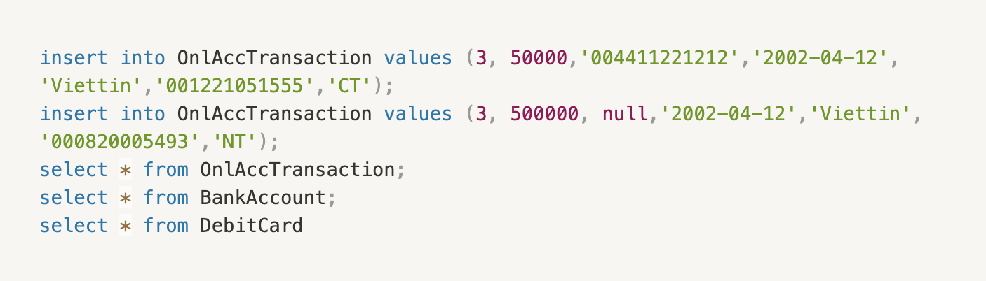
TUNING AND MANIPULATING BANK_TRANSACTION DATABASE
Trigger for Online transaction our database
We test with the following context:
•Account 001221051555 transfer 50000 to account 004411221212
•Account 000820005493 deposits 500000

Slide 46
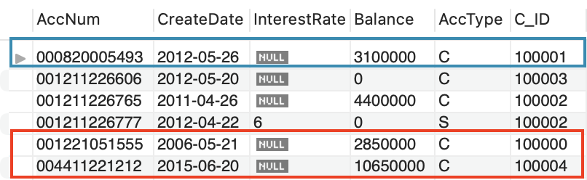
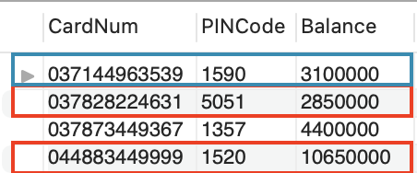
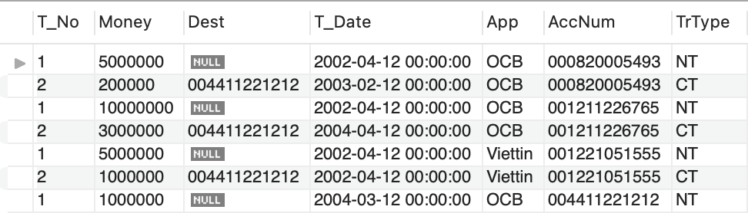
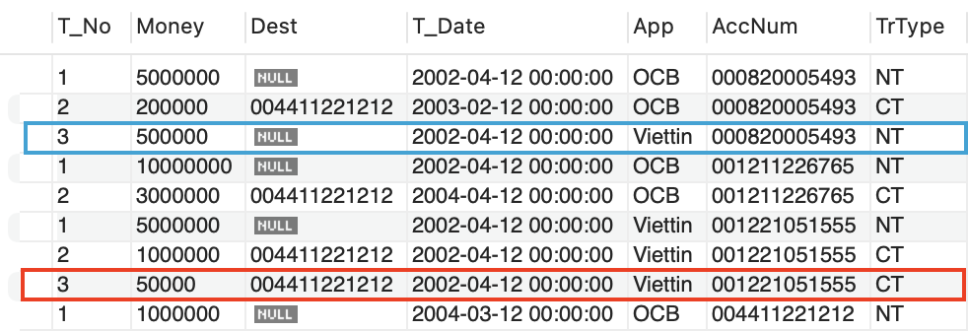
TUNING AND MANIPULATING BANK_TRANSACTION DATABASE
Trigger for Online transaction our database

Slide 47
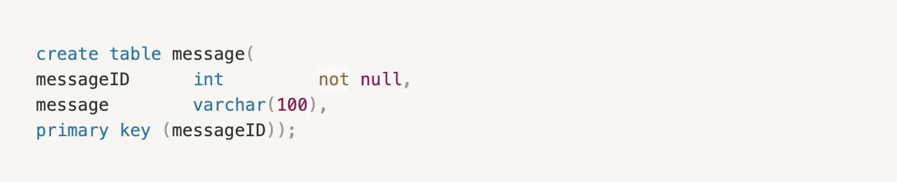
TUNING AND MANIPULATING BANK_TRANSACTION DATABASE
Trigger for BankStaff in our database
Trigger for Customer to detect whether age is less than 0.
Messagetable will annouce when inserting a customer’s age < 0 and need to update

Slide 48
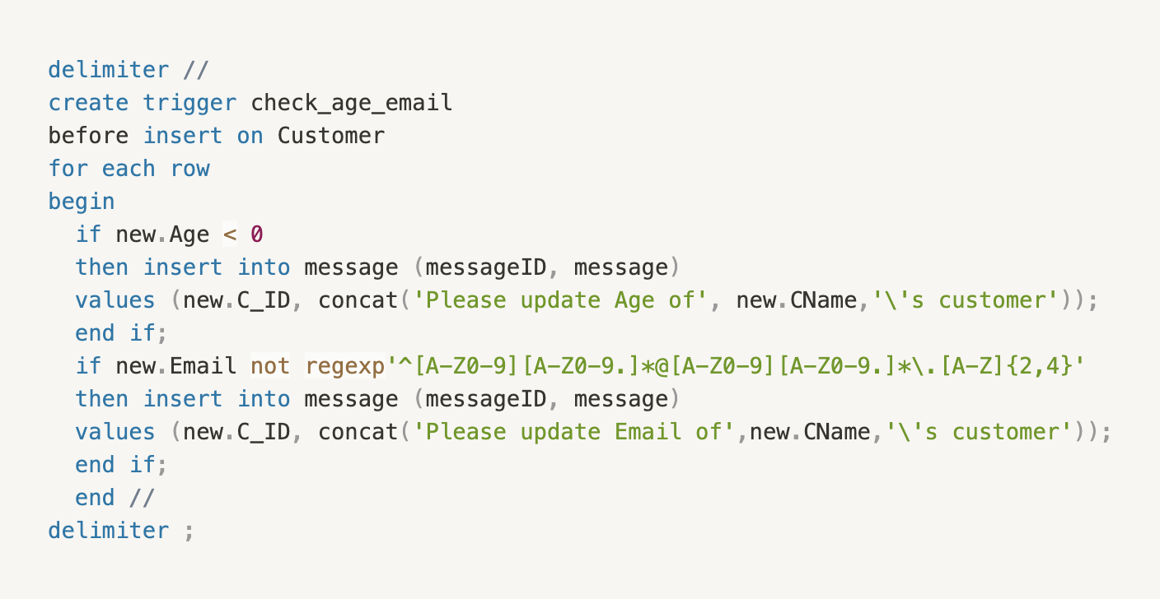
TUNING AND MANIPULATING BANK_TRANSACTION DATABASE
Trigger for BankStaff in our database
Trigger for Customer to detect whether age is less than 0.
Messagetable will annouce when inserting a customer’s age < 0 and need to update

Slide 49
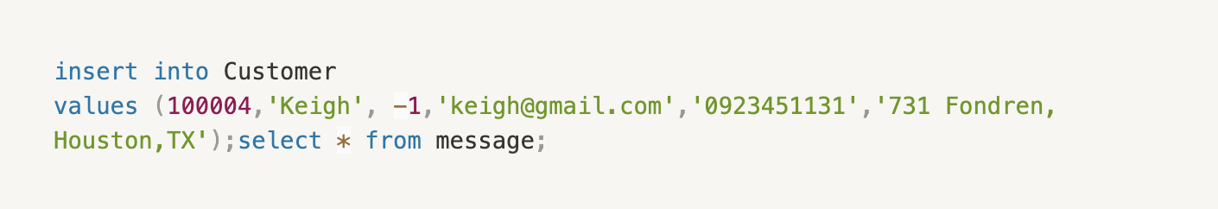
TUNING AND MANIPULATING BANK_TRANSACTION DATABASE
Trigger for BankStaff in our database
Trigger 2 for Customer to detect whether age is less than 0.
Messagetable will annouce when inserting a customer’s age < 0 and need to update
Check whether our trigger works

Slide 50
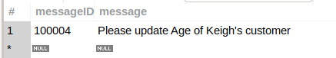
TUNING AND MANIPULATING BANK_TRANSACTION DATABASE
Trigger for BankStaff in our database
Trigger 2 for Customer to detect whether age is less than 0.
Messagetable will annouce when inserting a customer’s age < 0 and need to update
Check whether our trigger works

Slide 51
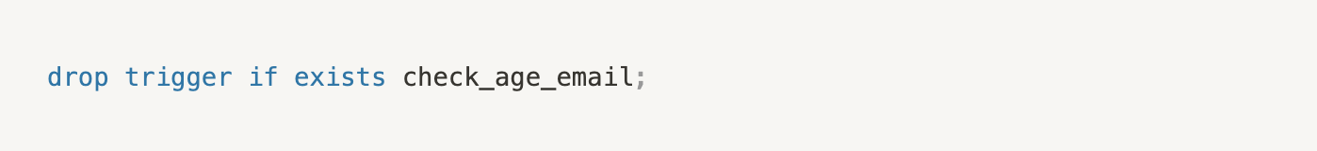
TUNING AND MANIPULATING BANK_TRANSACTION DATABASE
Trigger for BankStaff in our database
Trigger 2 for Customer to detect whether age is less than 0.
Messagetable will annouce when inserting a customer’s age < 0 and need to update
You can drop this trigger if you want.

Slide 52
TUNING AND MANIPULATING BANK_TRANSACTION DATABASE
Procedure for our database
In trigger 2, it’s not prevent new value from inserting into Customer’s table.

Slide 53
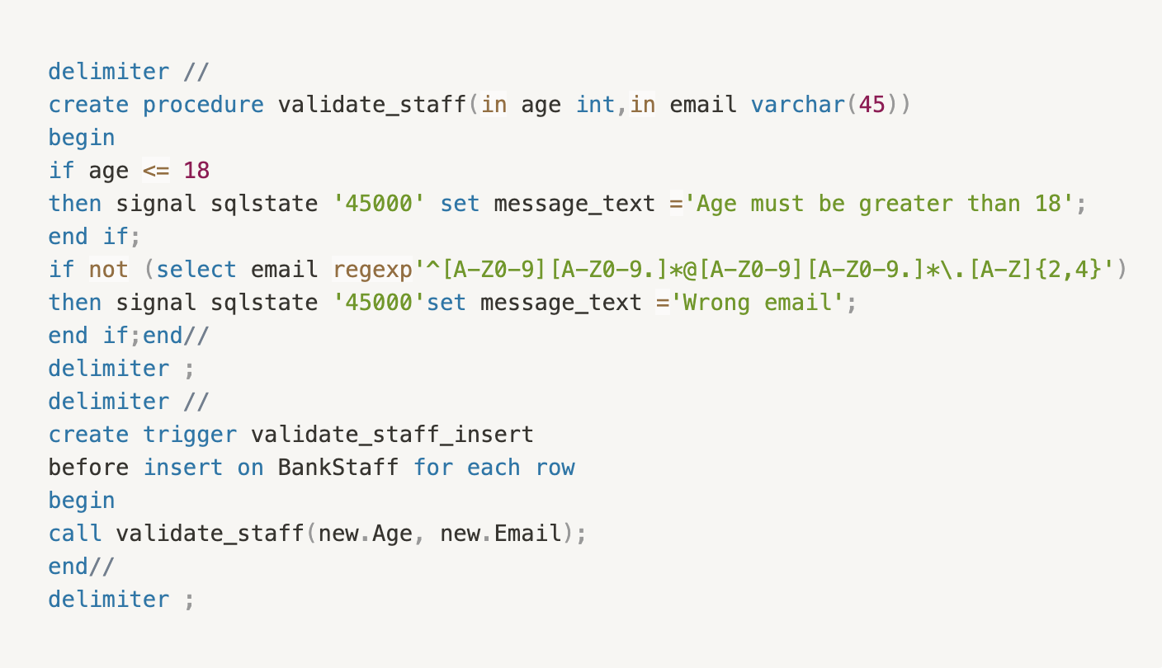
TUNING AND MANIPULATING BANK_TRANSACTION DATABASE
Procedure for our database
Now we will create another trigger and procedure for BankStaff’s table in order to check Age of staffs who must be greater than 18 years old and valid emails for them. The insertion will not be allowed unless it meet the requirements.

Slide 54
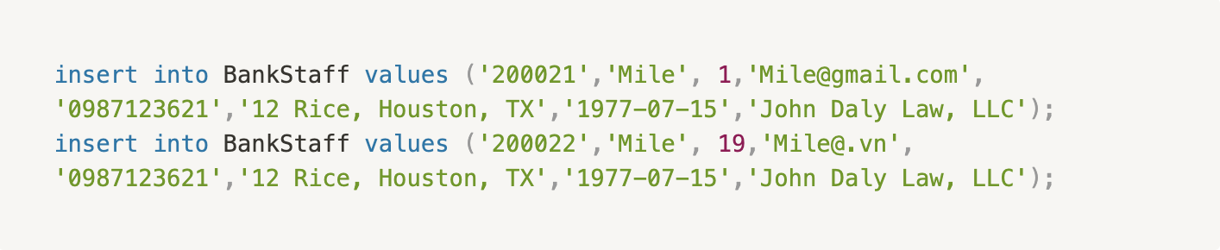
TUNING AND MANIPULATING BANK_TRANSACTION DATABASE
Procedure for our database
Now we will create another trigger and procedure for BankStaff’s table in order to check Age of staffs who must be greater than 18 years old and valid emails for them. The insertion will not be allowed unless it meet the requirements.
Let check whether our procedure and trigger work

Slide 55
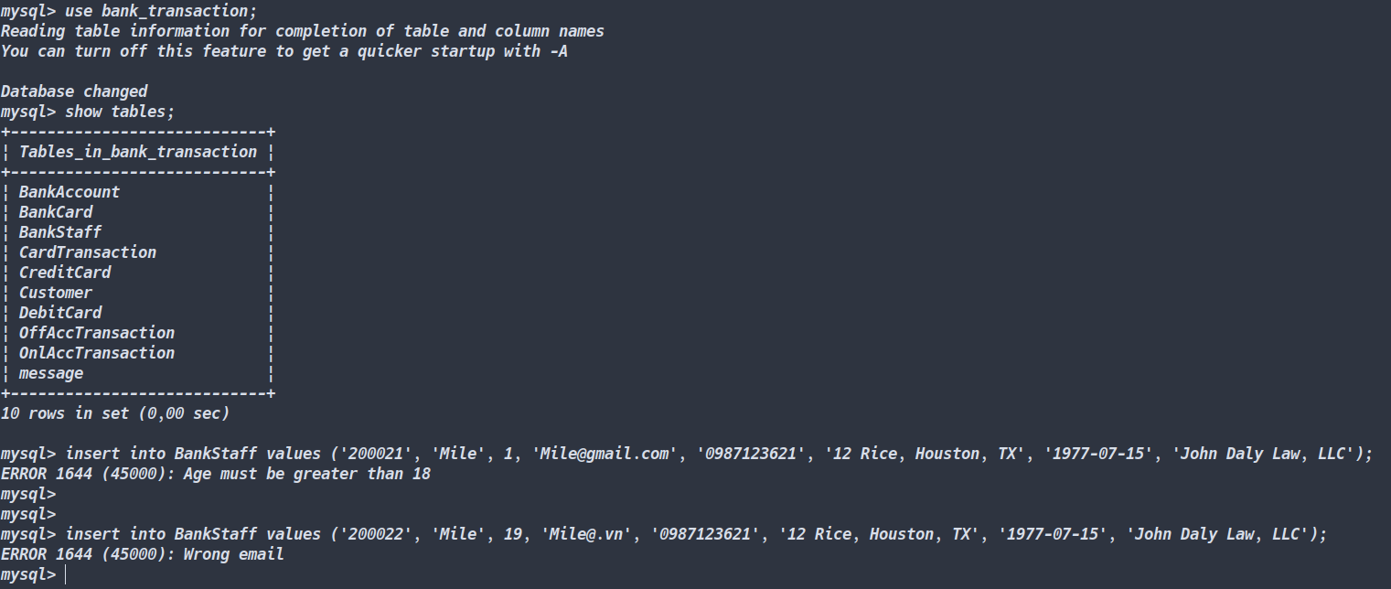
TUNING AND MANIPULATING BANK_TRANSACTION DATABASE
Procedure for our database
Now we will create another trigger and procedure for BankStaff’s table in order to check Age of staffs who must be greater than 18 years old and valid emails for them. The insertion will not be allowed unless it meet the requirements.
Let check whether our procedure and trigger work

Slide 56
TUNING AND MANIPULATING BANK_TRANSACTION DATABASE
Indexing for our database
Advantages of using indexes
Indexes are used to find rows with specific column values quickly. Without an index, MySQL must begin with the first row and then read through the entire table to find the relevant rows. The larger the table, the more this costs. If the table has an index for the columns in question, MySQL can quickly determine the position to seek to in the middle of the data file without having to look at all the data.

Slide 57

TUNING AND MANIPULATING BANK_TRANSACTION DATABASE
Indexing for our database
Demonstration
Firstly, we create index, namely cus_index on Age attribute of Customer’s table and use the following code

Slide 58
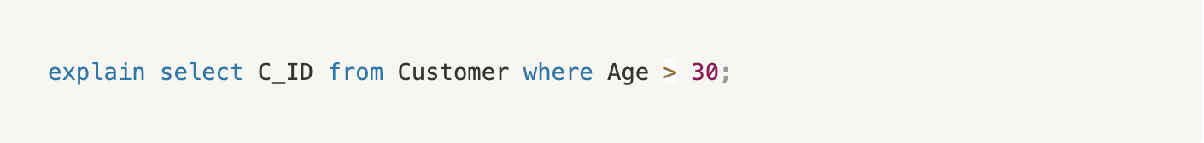
TUNING AND MANIPULATING BANK_TRANSACTION DATABASE
Indexing for our database
Demonstration
Firstly, we create index, namely cus_index on Age attribute of Customer’s table and use the following code
Then we check how fast it is when using index andEXPLAINclauseto find customers who are greater than 30 years old:

Slide 59
TUNING AND MANIPULATING BANK_TRANSACTION DATABASE
Indexing for our database
Demonstration
Then we check how fast it is when using index andEXPLAINclauseto find customers who are greater than 30 years old:

Slide 60
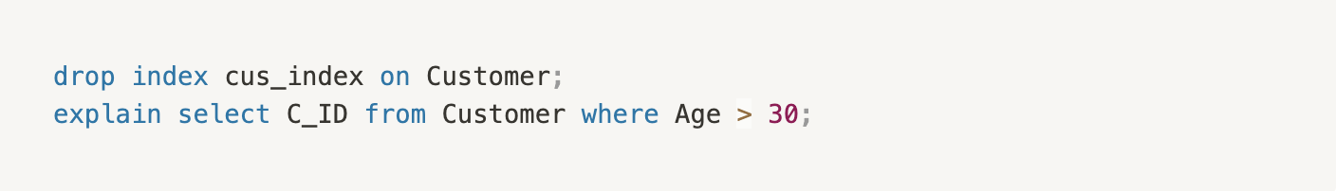
TUNING AND MANIPULATING BANK_TRANSACTION DATABASE
Indexing for our database
Demonstration
Then we check how fast it is when using index and EXPLAIN clause to find customers who are greater than 30 years old:
Now we drop this index and use EXPLAIN clause again to compare the fast without using index.

Slide 61
TUNING AND MANIPULATING BANK_TRANSACTION DATABASE
Indexing for our database
Demonstration
Now we drop this index and use EXPLAIN clause again to compare the fast without using index.

Slide 62
TUNING AND MANIPULATING BANK_TRANSACTION DATABASE
Indexing for our database
Demonstration
As you can see from the second figure, there are no index used by DBMS to find the Age attribute and there are 2 filtered rows. In the contrast, in the first figure there is only 1 filtered row. Because we only inserted a little bit data to our database so we don’t see the differences between them. If there are lots of data in relations, then using indexes is always better than without using them.

Slide 63
05
AN APPLICATION ON TOP OF THE DESIGNED DB SYSTEM

Slide 64

AN APPLICATION ON TOP OF THE DESIGNED DB SYSTEM
Demonstration
Firstly, we create a GUI(graphical user interface) and connect it to Mysql in Java (Netbeans) and using mysql-connector-java like this.

Slide 65

AN APPLICATION ON TOP OF THE DESIGNED DB SYSTEM
Demonstration
Next, let move on to file in menu bar, there are three table to tackle data that is Customer, BankCard, Account residing in file. Begin with Customer

Slide 66

AN APPLICATION ON TOP OF THE DESIGNED DB SYSTEM
Demonstration
Now, let insert one value to our database.

Slide 67
AN APPLICATION ON TOP OF THE DESIGNED DB SYSTEM
Demonstration
Now, let insert one value to our database.

Slide 68

AN APPLICATION ON TOP OF THE DESIGNED DB SYSTEM
Demonstration
Continue to Account interface( abbreviate for BankAccount). When inserting data into BankAccount, result look like this.

Slide 69

AN APPLICATION ON TOP OF THE DESIGNED DB SYSTEM
Demonstration
Continue to Account interface( abbreviate for BankAccount). When inserting data into BankAccount, result look like this.

Slide 70

AN APPLICATION ON TOP OF THE DESIGNED DB SYSTEM
Demonstration
And for BankCard interface which shows the same result.

Slide 71
AN APPLICATION ON TOP OF THE DESIGNED DB SYSTEM
Demonstration
And for BankCard interface which shows the same result.

Slide 72

AN APPLICATION ON TOP OF THE DESIGNED DB SYSTEM
Demonstration
Now, go to transact money in Transaction menu.

Slide 73

AN APPLICATION ON TOP OF THE DESIGNED DB SYSTEM
Demonstration
Now, go to transact money in Transaction menu.

Slide 74

AN APPLICATION ON TOP OF THE DESIGNED DB SYSTEM
Demonstration
If you find this Account Number again, the result looks like this

Slide 75

AN APPLICATION ON TOP OF THE DESIGNED DB SYSTEM
Demonstration
If you find this Account Number again, the result looks like this

Slide 76

AN APPLICATION ON TOP OF THE DESIGNED DB SYSTEM
Demonstration
Our application also help to transfer money between Account’s number. Now, let see what’s in Transfer interface.

Slide 77

AN APPLICATION ON TOP OF THE DESIGNED DB SYSTEM
Demonstration
Now we want to transfer money to Account Number 37873449367 with amount 59999 transferred.

Slide 78

AN APPLICATION ON TOP OF THE DESIGNED DB SYSTEM
Demonstration
Now we want to transfer money to Account Number 37873449367 with amount 59999 transferred.

Slide 79
AN APPLICATION ON TOP OF THE DESIGNED DB SYSTEM
Demonstration
Now we want to transfer money to Account Number 37873449367 with amount 59999 transferred.

Slide 80
05
CONCLUSION

Slide 81
CONCLUSION
Firstly, we completed insertion initial data to the DBMS, we tried to make it consistent. The data will then be used for query. Secondly, we discussed about Normal Form and Functional Dependency. Following with its theory, we analyze our database based on that and we concluded that all relations in Bank Transaction database is in Boy-Codd Normal Form.
In the next part, we discuss about security including access control, interface control, flow control, data encryption. We also have a demonstration about security on granting privilege.
The most interesting section to us is the two next sections. The first one is about tuning data. We do querying data, creating trigger and procedure for relations in our database. Trigger is very important in our database because it make our database consistent. We have demonstrated triggers for making insertion of online account transaction consistent and one for validate staff insertion. Further work is still need to make our whole database consistent. For other transaction relations, the step will be similar to the Online Transaction. The next one is about create a top application for our database. Although it is not totally completed, it provided basic functions for user to work with our database. Moreover, the application will be updated in the near future to make it work better with more functions.

